Slide 1
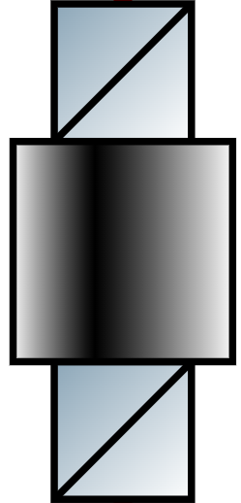

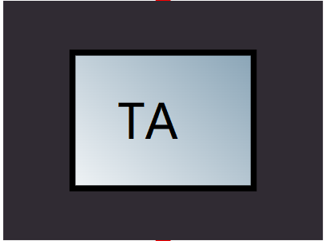







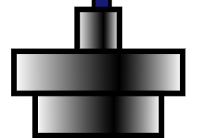






952nm Laser
Cylindrical
Lenses
Fast,Slow
$$\frac{λ}{2}$$
FiberEOM
952nm
ULE
$$\frac{λ}{2}$$
$$\frac{λ}{4}$$
$$\frac{λ}{4}$$
PDH Lock
HC Lock
Main Experiment

Slide 2
952nm Laser
Cylindrical
Lenses
Fast,Slow
$$\frac{λ}{2}$$
FiberEOM
952nm
ULE
$$\frac{λ}{2}$$
$$\frac{λ}{4}$$
$$\frac{λ}{4}$$
PDH Lock
HC Lock
Main Experiment

